Slide 1
Measuring Magnetic Reconnection in Solar Flares
Audrey Robison
REU Summer 2022 MSU Advisor: Dr. Jiong Qiu

Slide 2
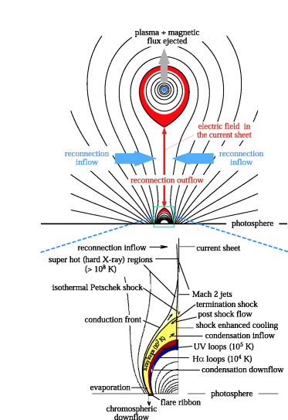
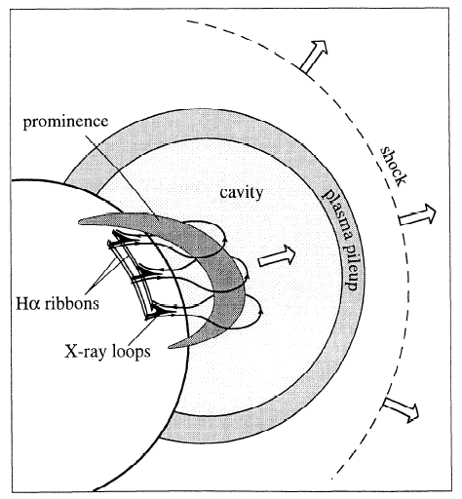
Magnetic Reconnection on the Sun’s Surface
Forbes- Lin model
Notes:
What is the solar flare, how is it associated with magnetic reconnection. Flares are the bits left behind from Coronal Mass Ejections.

Slide 3
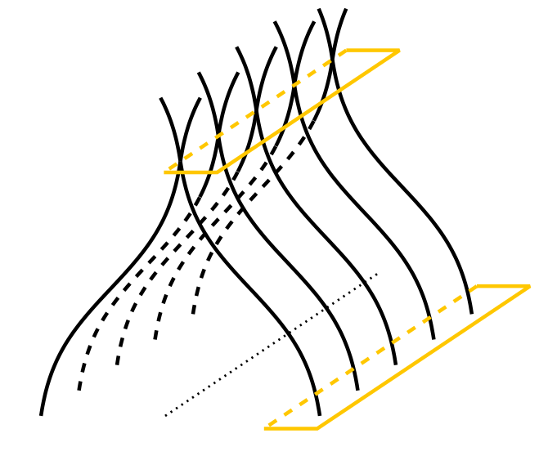
Theories of Reconnection
B_{in}
reconnection
V_{in}
dA_{in}
B_{R}
reconnection
rate (general)
dA_{R}
Terry Forbes
Notes:
Flare ribbons are the location where the energy flows into the chromosphere mapping where reconnection has taken place. Over time, as more field lines reconnect, the flare ribbons move outwards, as field lines further out have reconnected. The flare ribbons brighten before the loops brighten because there is a time delay of when the energy can travel up through the field lines to brighten. Thus, the flare ribbons brighten before their associated flare loops have brightened. As time progresses, the flare ribbons will bloat and travel outwards, as the inner lines have connected the outer lines will begin to connect.

Slide 4
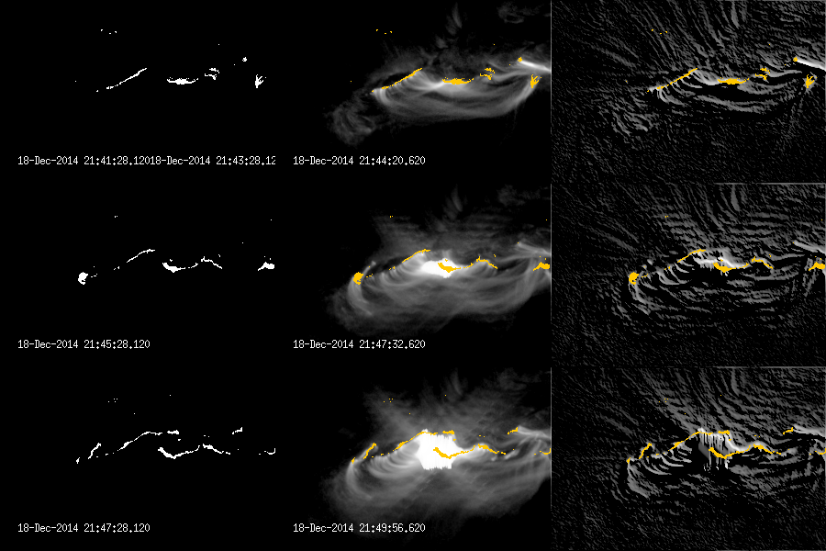

Mapping
$$Φ_{B}= \int{B_{in}}{dA}_{in}=\int{B_{R}}dA_{R}$$
Notes:
The amount of flux out must equal the amount of flux into the page. Using the identified flare pixels we can measure the flux in and out of the page using our magnetic data. Using this data over time we can estimate the rate of reconnection by taking an integral of this value. In this first image we have mapped the flare pixels with the general pixels that they connect to because the portion of flux in the blue is equal to the amount of flux in the blue on the other side.

Slide 5
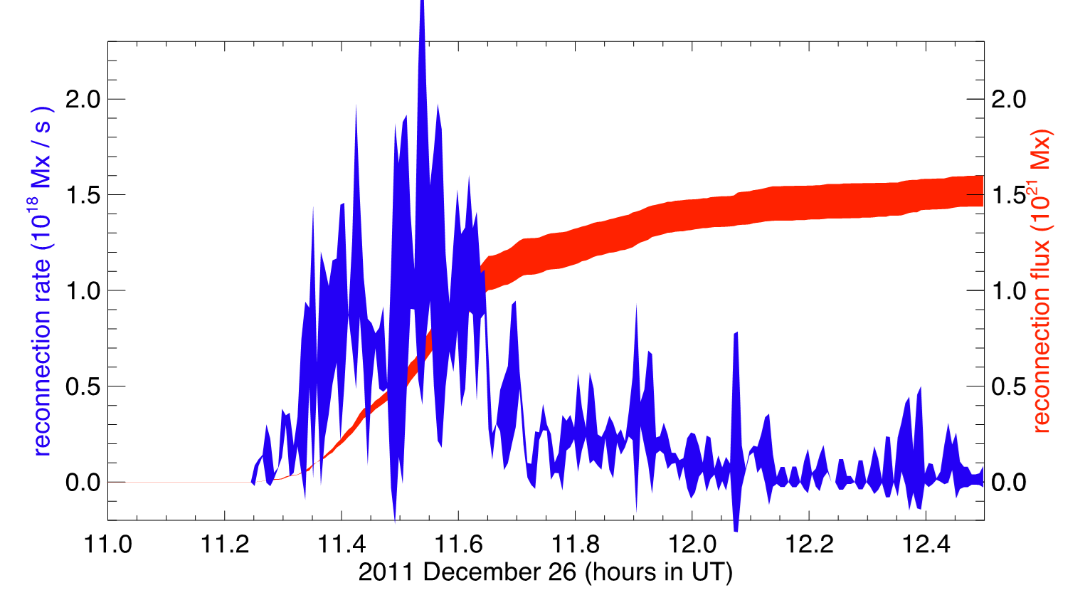
Measuring the Reconnection Rate
Notes:
The blue line indicates the reconnection rate, the integral of the reconnection flux. For my first project I was able to reproduce this graph with the data from a particular solar flare .

Slide 6
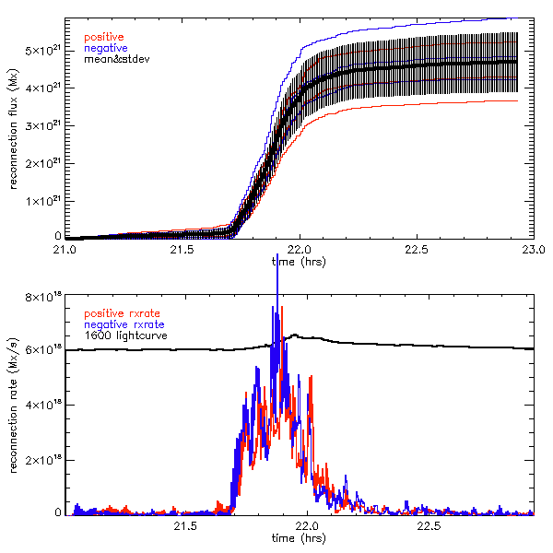
Notes:
Blue line is negative red line is positive we’ve taken the absolute value, so it doesn’t cancel out. There’s a discrepancy due to sources of error.

Slide 7
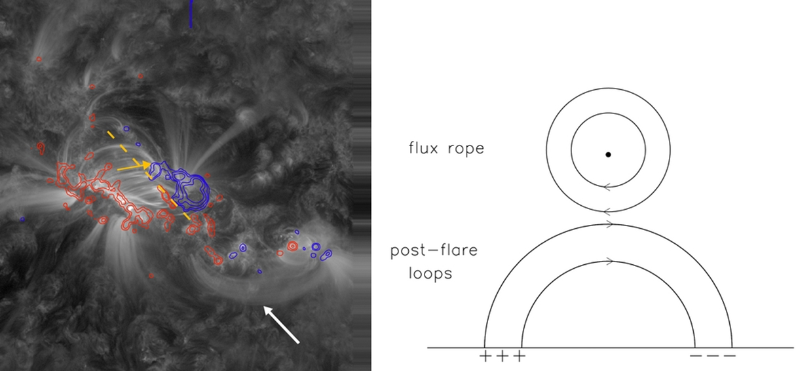
Mapping Reconnection Between Flare Ribbons
Yurchyshyn et al. 2001, Leamon et al. 2004, Hu et al. 2014
Notes:
The difficulty is in modelling exactly how the loops connect over time/space. We know that the inner most edges of the flare ribbons must connect but we do not know how it connects, at what angle and to what part of the flare ribbons. My project will allow us to make a model to mathematically predict how flares will connect, and thus allow us to make an estimate of the relative guide field.

Slide 8
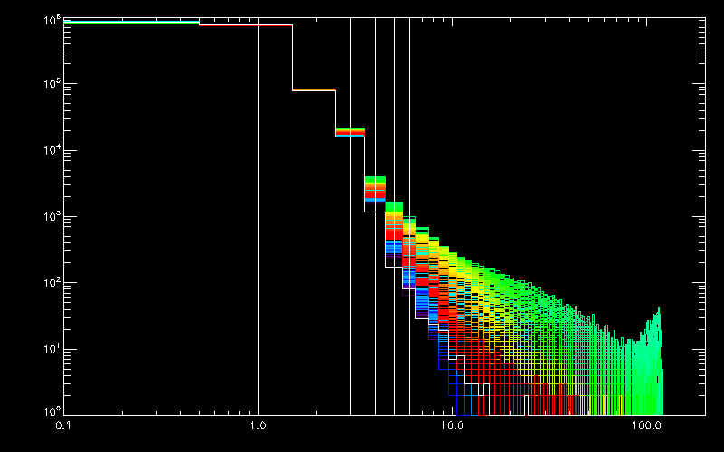
Flare Pixel Identification
Notes:
Withing our models, it is essential to identify which pixels are the location of the feet of the flare ribbons. This data visualization I created in my first week of the REU illustrates the bounds for our identification of which pixels indicate the location of the feet of the solar flare. This is a histogram with the number of pixels on the y axis and the brightness on the x axis. The white lines indicate median brightness, the lines at 3,4,5,6 represent 3x, 4x, 5x, 6x background brightness. At approximately 4x background brightness, the flare pixels diverge from the background pixels. Moving forward, we will use this data representation to justify our choice of using 6x the background brightness as a conservative estimate of when the flare pixels separate from the regular pixels.

Slide 9
Objective of this Study
To determine how flares reconnect between flare ribbons
Determine how the shear of the flare loops evolves with time
Mathematically estimate the relative guide field, based on the result of programming model of flare loops constrained by observation
Notes:
By creating a mathematical model describing the geometry of reconnection, we can mathematically describe the value of the guide force. If inner guide lines are more angled than outer guidelines, we know that the guide force has lost its strength over space/time. If our model fits our observations, we can safely determine that our rough estimate for the relative guide field is accurate. Thus, we will have a rough start of a model to represent how flare loops connect over space/time.
Relative: we know the ratio of the guide field relative to B. If our model correlates to

Slide 10
